Slide 1

FLEXERA
Integrated Energy + Digital Infrastructure Platform
Africa Pilot (Phase I–II) | Base Case CAPEX: $110 million | IRR Target Equity IRR: 16–18%
AFRICA (PILOT) → MULTI-COUNTRY DEPLOYMENT (USA, MIDDLE EAST, AFRICA)

Slide 2
FLEXERA
KEY INVESTMENT POINTS (BASE CASE)
Hybrid platform: Solar PPA + Mid-Scale Data Center (5–10 MW IT) + BESS/Ice + VPP SaaS
Phase I–II CAPEX: $110 million (pilot) with modular replication
Conservative pricing: PPA $0.11–$0.13/kWh (base $0.12)
Occupancy Ramp: 60% by Year 3; 75% by Year 5
Blended finance angle (AfDB/IFC style) to improve bankability + downside proctection
$110M
16–18%
$0.11–0.13
Base Case Capex (Phase I–II)
Target Equity IRR (Conservative)
PPA Range (USD/kWh)

Slide 3
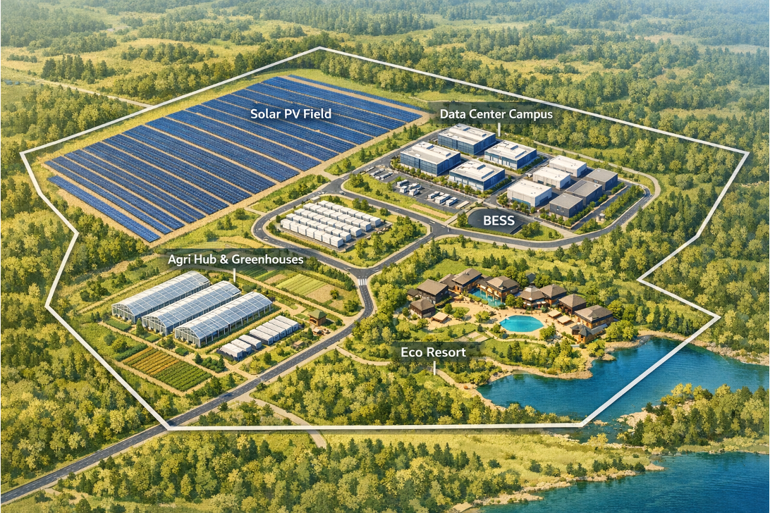
FLEXERA
MASTER PLAN (AFRICA PILOT)
PV Field | Ice Thermal Storage | BESS yard| Data Center Campus | VPP Control Center | Training | POI/Grid

Slide 4
FLEXERA
PLATFORM OVERVIEW
Dispatchable energy: PV + BESS + Ice shifting for DC and grid services
Digitization: VPP SaaS for aggregation, forecasting, and dispatch
Services: Training and studies for industrial clients and utilities
Revenue stacking: energy + ancillary services + software + services
PV
Ice
BESS
DC Loads
VPP SaaS
Grid/POI

Slide 5
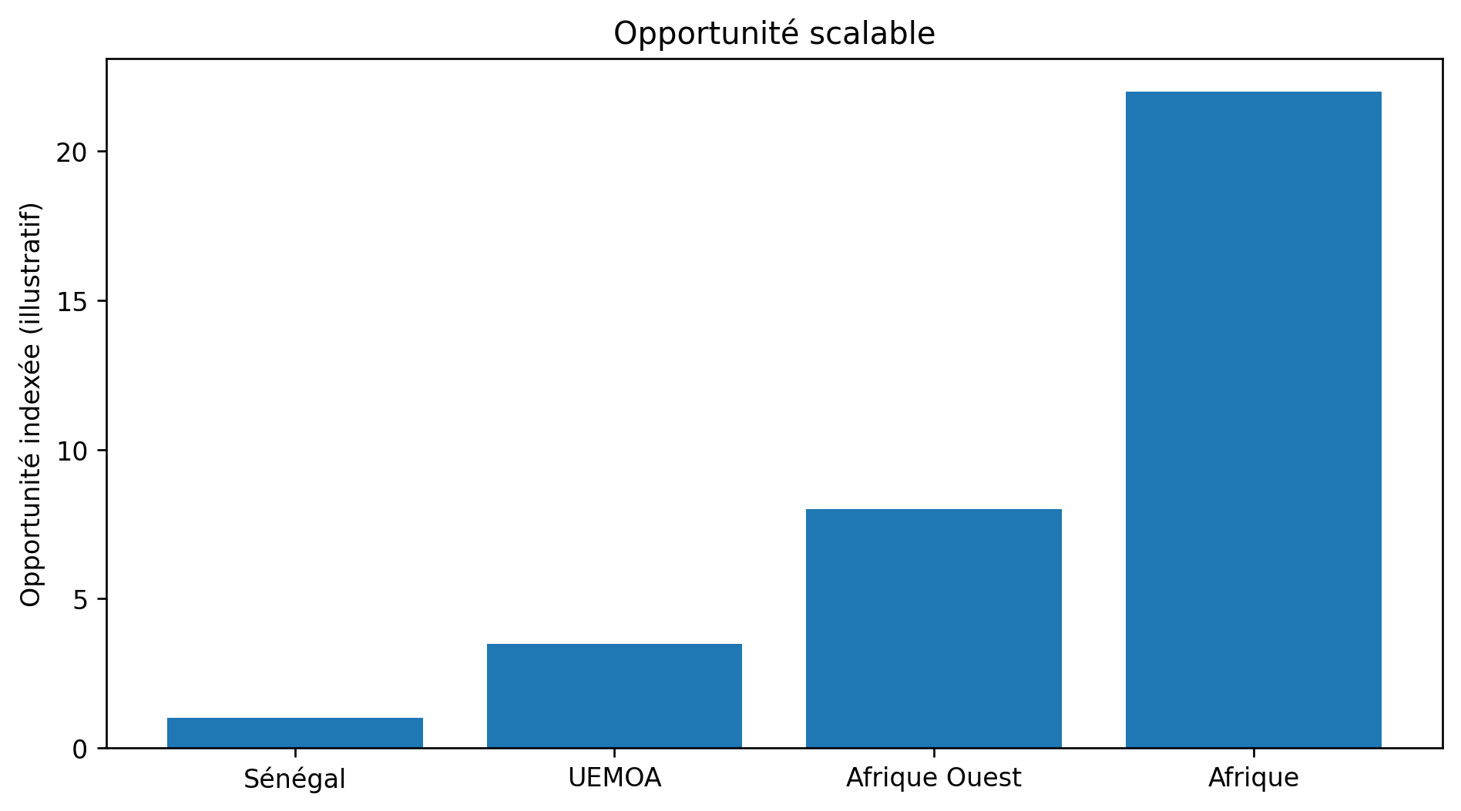
FLEXERA
MARKET CONTEXT (AFRICA → REGION)
Growing power demand + grid constraints drive need for storage + flexible resources
Data center demand accelerating across West Africa; Senegal positioned for regional connectivity
VPP adoption rising with renewable penetration and utility modernization

Slide 6
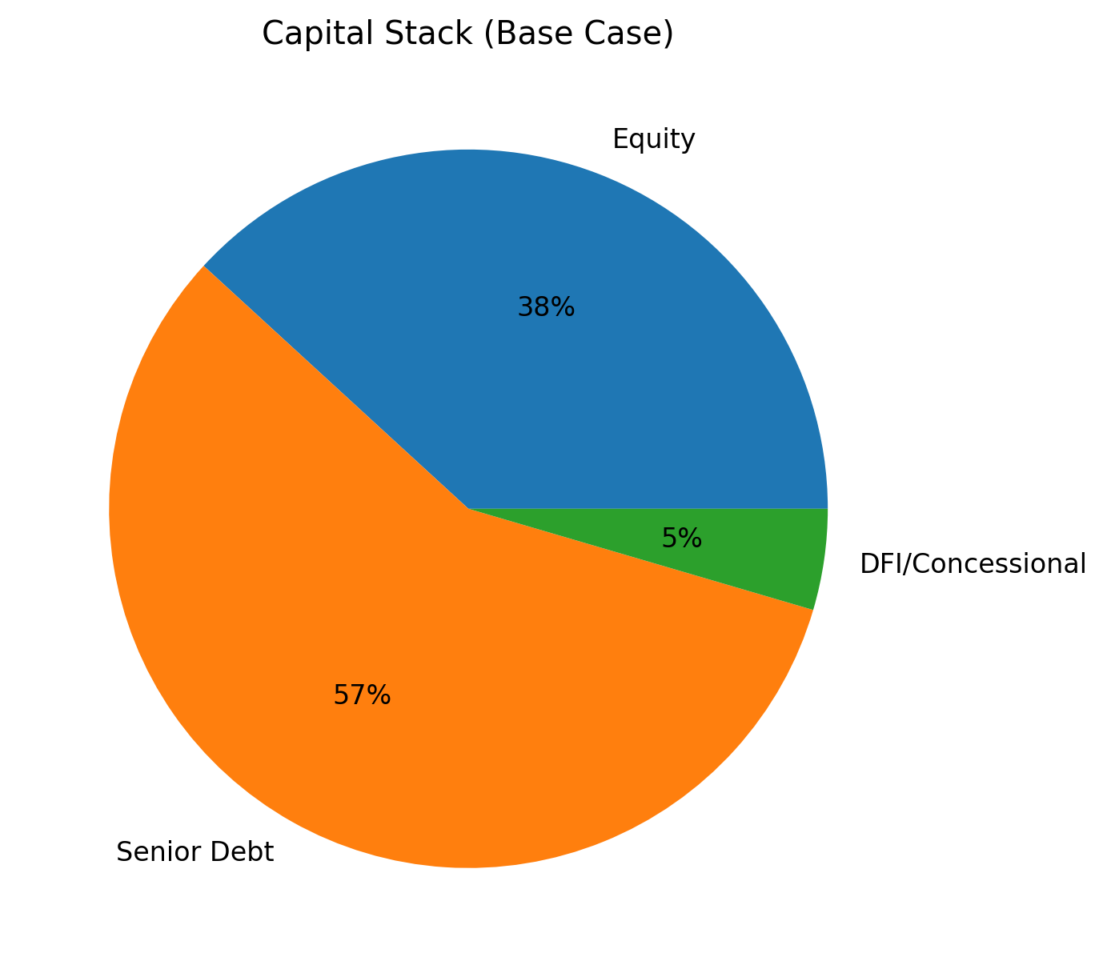
FLEXERA
CAPITAL STRUCTURE (CONFIRMED)
COMPONENT | USD m | %
Equity | 42 | 38%
Senior debt @ 8% | 63 | 57%
DFI / concessional | 5 | 5%
Total | 110 | 100%
Tenor debt: 10 years | Straight-line depreciation
Annual Principal: 6.3 | Rate: 8%

Slide 7
FLEXERA
SOURCES & USES (BASIC CASE)
SOURCES | USD m
Equity | 42.0
This senior | 63.0
DFI / concessional | 5.0
Total | 110.0
EMPLOIS | USD m
Solar + POI | 38
Data center (5–10 MW IT) | 48
BESS + Ice | 16
VPP SaaS + Training | 8
Total | 110.0

Slide 8
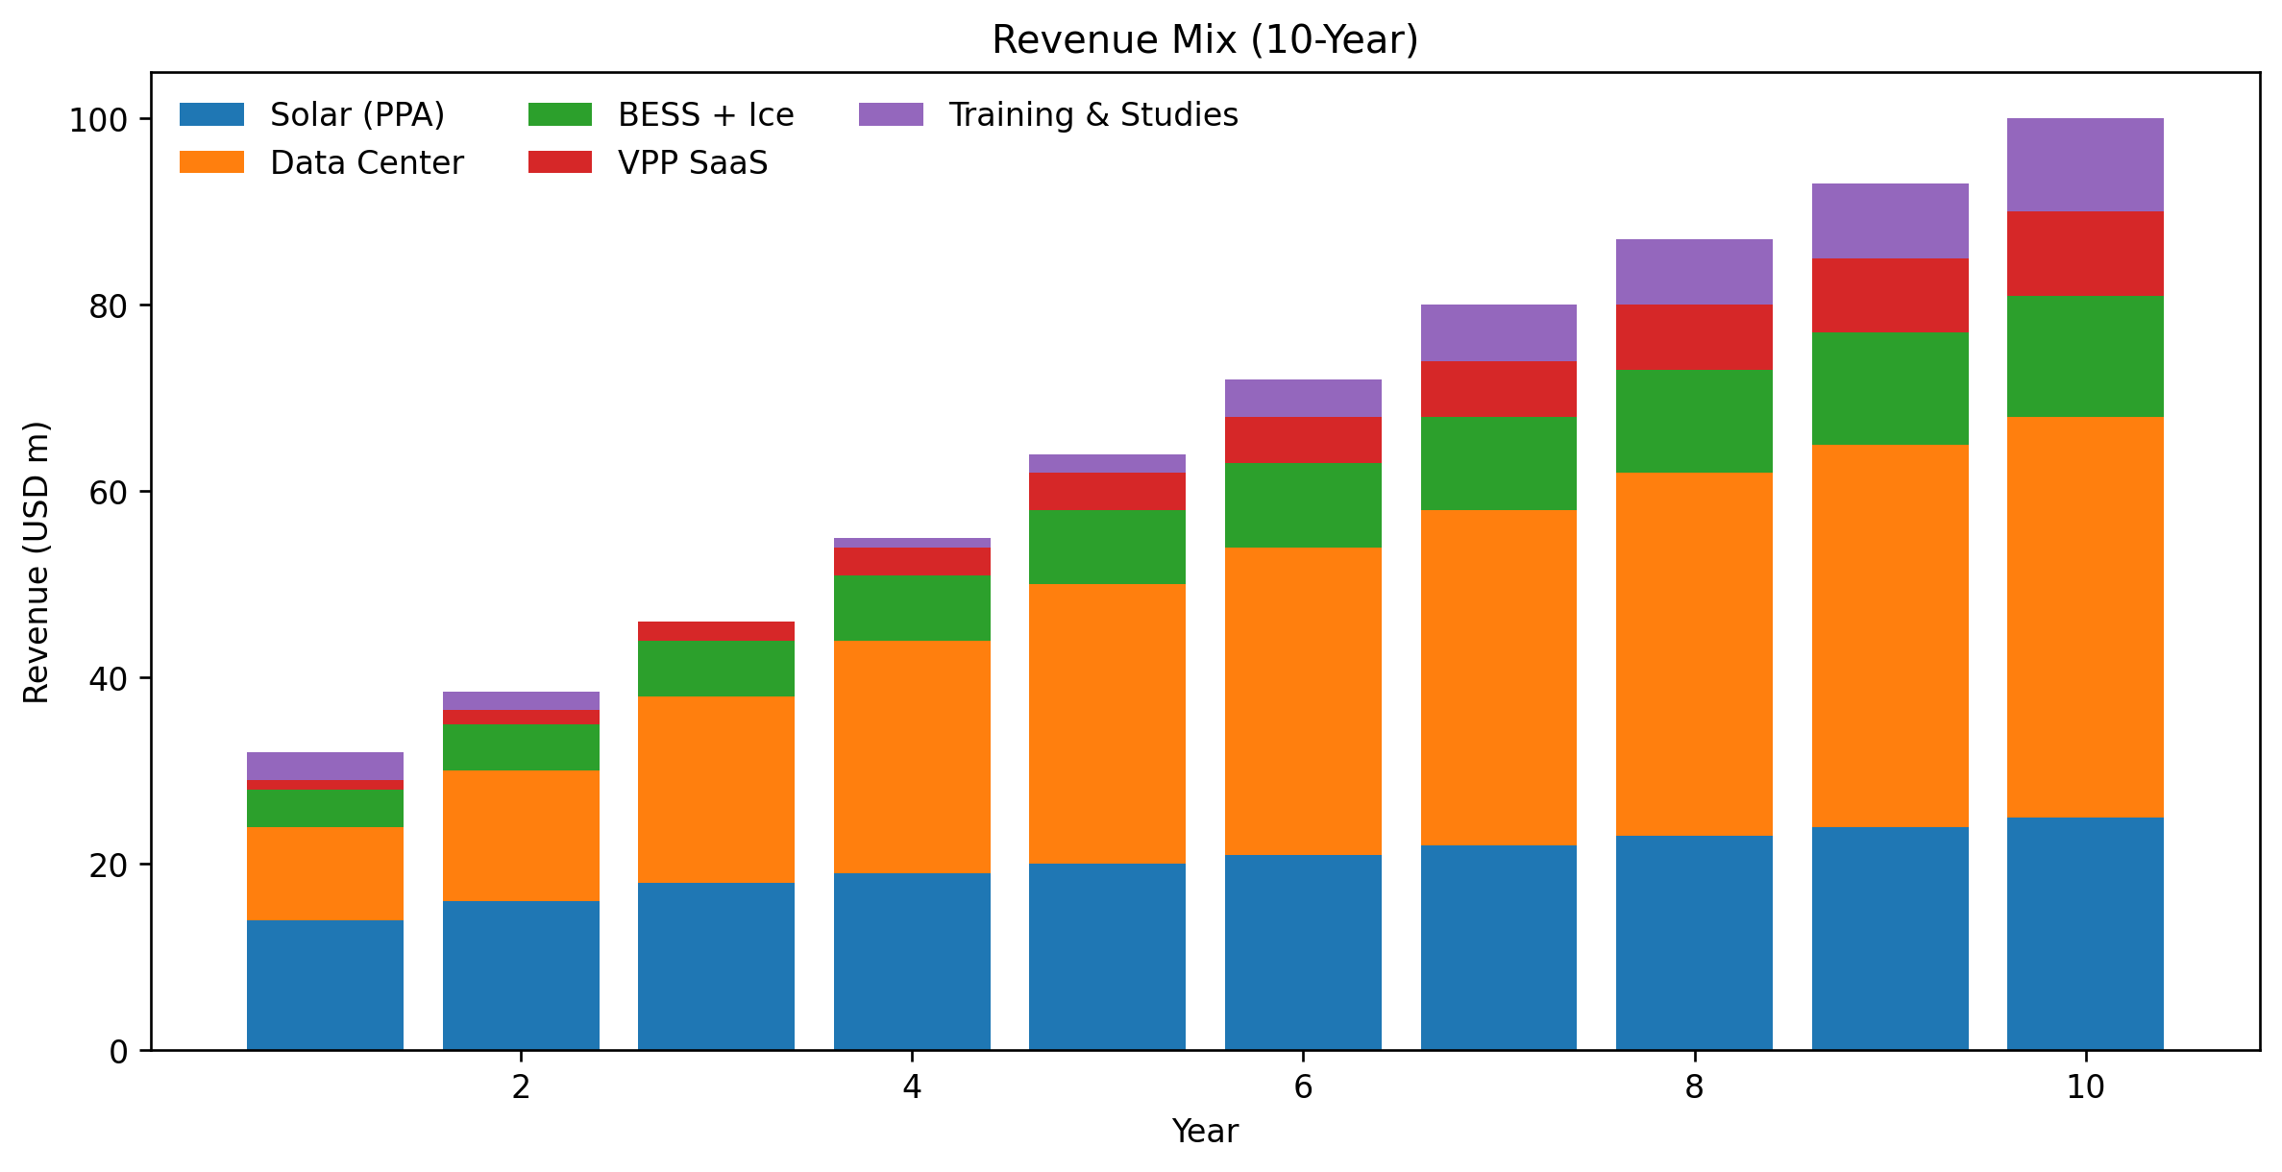
FLEXERA
REVENUE MODEL (10-YEAR PROJECTION)
PPP base 0.12 USD/kWh | DC ramp: 60% Y3; 75% Y5

Slide 9
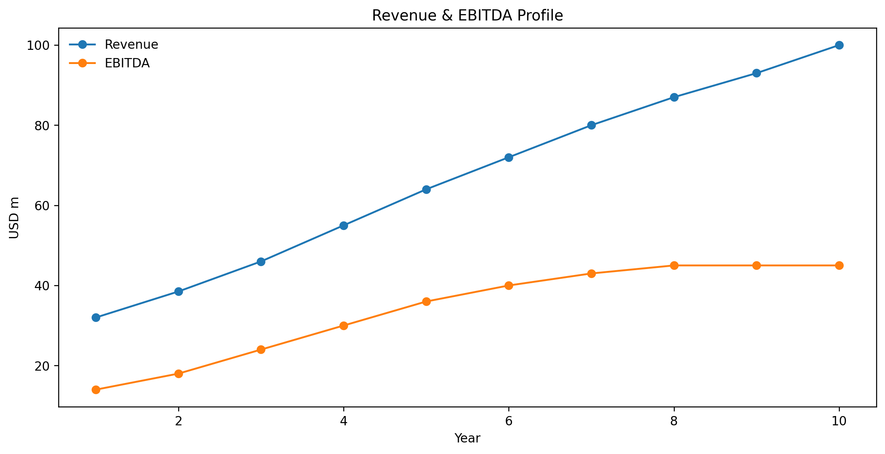
FLEXERA
EBITDA PROFILE & MARGIN LOGIC
Steady-state EBITDA: $45 million with stacked optimization (BESS/Ice + VPP).

Slide 10
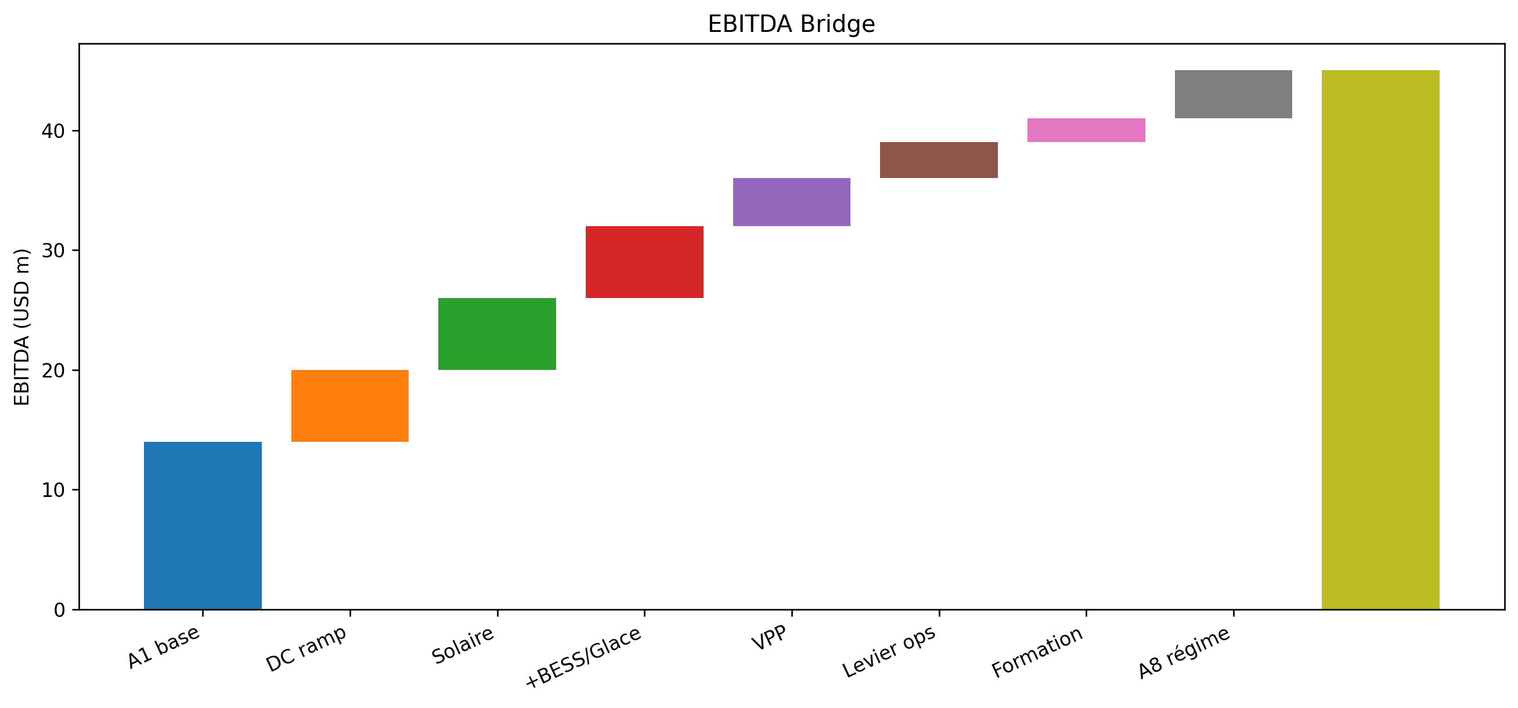
FLEXERA
EBITDA BRIDGE (Y1 → STATE)

Slide 11
FLEXERA
DEBT AMORTIZATION (SENIOR DEBT @ 8%, 10Y)
YEAR | OPENING | INTEREST | PRINCIPAL | CLOSING
1 | 63.0 | 5.04 | 6.3 | 56.7
2 | 56.7 | 4.54 | 6.3 | 50.4
3 | 50.4 | 4.03 | 6.3 | 44.1
4 | 44.1 | 3.53 | 6.3 | 37.8
5 | 37.8 | 3.02 | 6.3 | 31.5
6 | 31.5 | 2.52 | 6.3 | 25.2
7 | 25.2 | 2.02 | 6.3 | 18.9
8 | 18.9 | 1.51 | 6.3 | 12.6
9 | 12.6 | 1.01 | 6.3 | 6.3
10 | 6.3 | 0.50 | 6.3 | 0.0

Slide 12
FLEXERA
DSCR SCHEDULE (CFADS = 85% EBITDA)
Year 1 DSCR slightly tight → DSRA/minor sculpting recommended.
YEAR | EBITDA | CFADS | DEBT SERVICE | DSCR
1 | 14 | 12 | 11.34 | 1.05
2 | 18 | 15 | 10.84 | 1.41
3 | 24 | 20 | 10.33 | 1.97
4 | 30 | 26 | 9.83 | 2.59
5 | 36 | 31 | 9.32 | 3.28
6 | 40 | 34 | 8.82 | 3.85
7 | 43 | 37 | 8.32 | 4.40
8 | 45 | 38 | 7.81 | 4.90
9 | 45 | 38 | 7.31 | 5.23
10 | 45 | 38 | 6.80 | 5.62

Slide 13
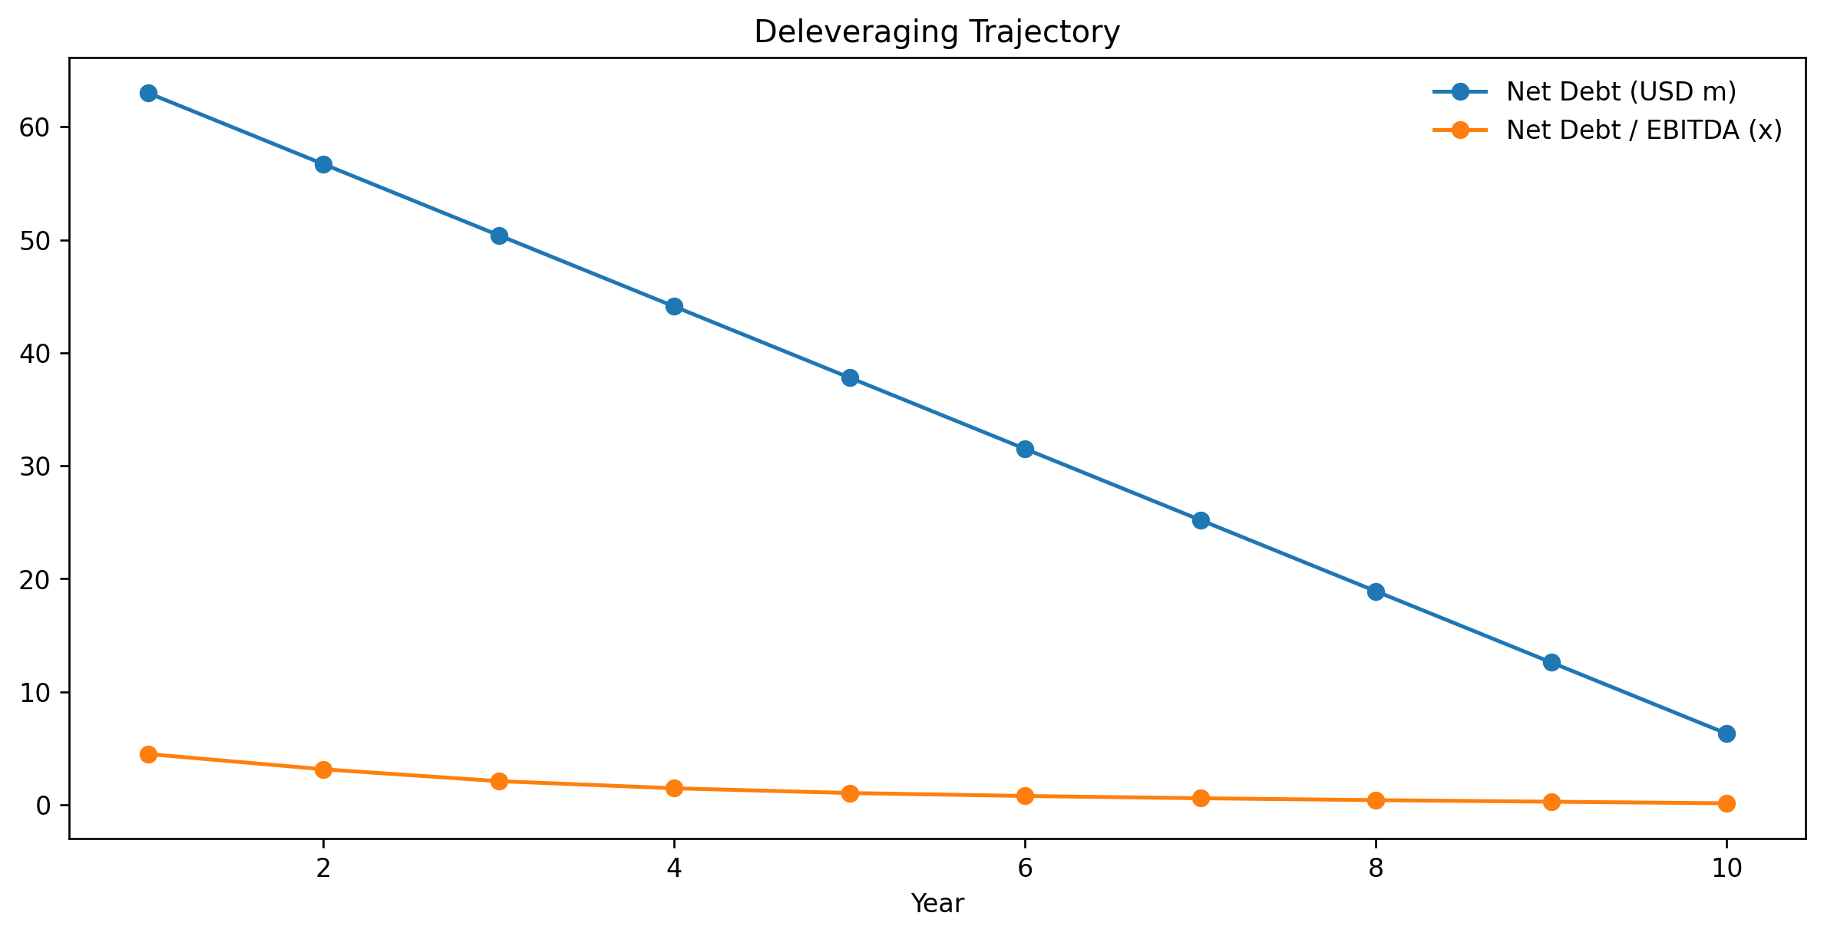
FLEXERA
CREDIT METRICS SUMMARY
METRIC | BASE CASE
Min DSCR | 1.05x
Avg DSCR (Y1–10) | 3.43x
Debt / EBITDA (start) | 4.5x
Debt / EBITDA (Y5) | 0.9x
Interest Coverage (Y3) | 6.0x
DSRA | Recommended

Slide 14
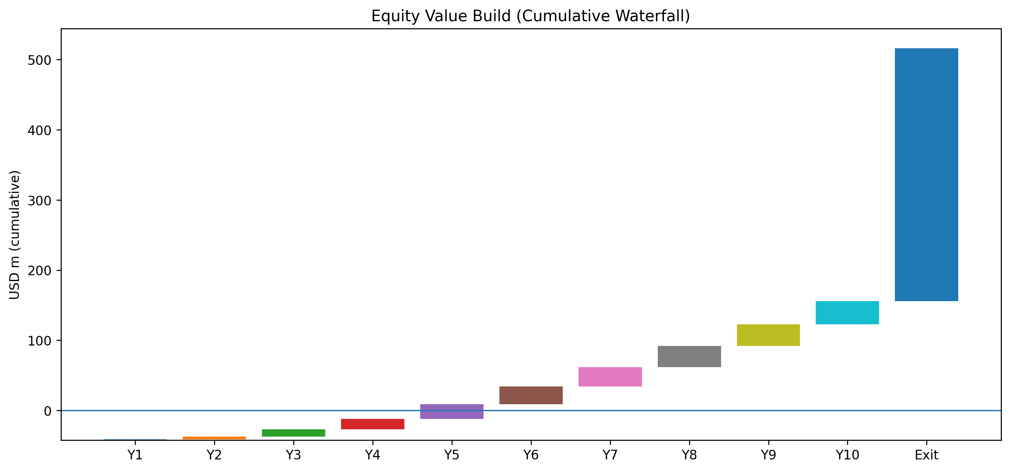
FLEXERA
VALUATION & EXIT LOGIC
EXIT EV: EBITDA 45 × 8.0x = $360M
Senior debt fully amortized by Year 10 (base case).
Equity IRR ~17.2% (within 16–18% target).
YEAR | EQUITY FCF (USD m)
1 | 1
2 | 4
3 | 10
4 | 15
5 | 21
6 | 25
7 | 28
8 | 30
9 | 31
10 | 33

Slide 15
FLEXERA
EQUITY IRR WATERFALL (CUMULATIVE)

Slide 16
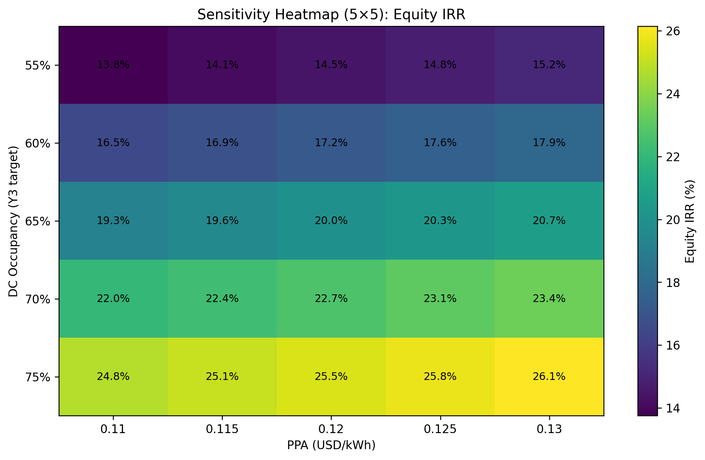
FLEXERA
SENSITIVITY HEATMAP (5×5) – EQUITY IRR

Slide 17
FLEXERA
WACC BREAKDOWN (BLENDED)
Item | Assumption
Cost of Equity | 18%
Cost of Senior Debt | 8%
DFI/Concession Cost | 3–5% (illustrative)
Weights (FP/D/DFI) | 38% / 57% / 5%
Blended WACC | ≈ 11,4–12,1%
Blended finance lowers effective WACC and improves DSCR stability.

Slide 18
FLEXERA
MIXED FINANCE STRUCTURING (DFI)
Senior Debt (Commercial)
DFI / Concessional (cushion)
Equity (First-loss)
Purpose: improve bankability, lowers WACC, stabilizes DSCR.

Slide 19
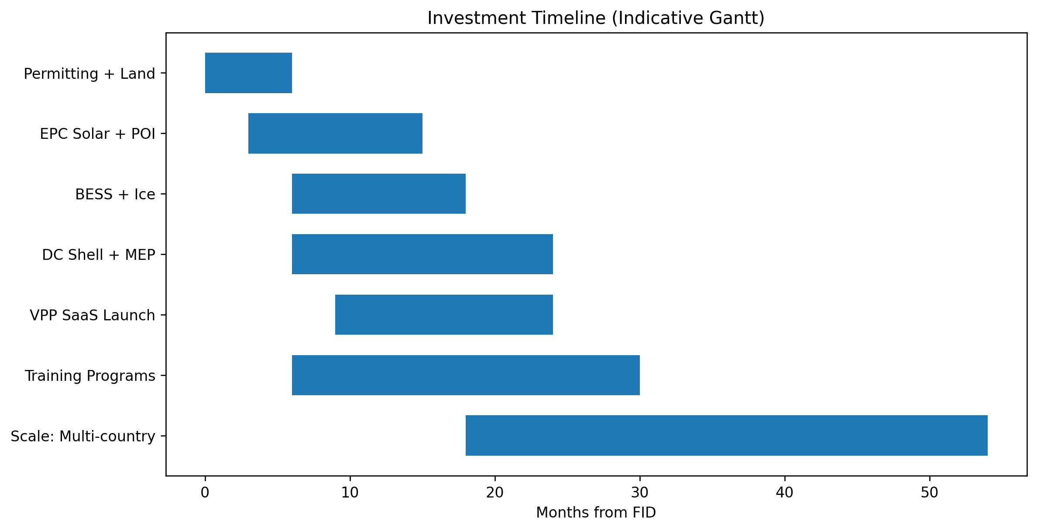
FLEXERA
INVESTMENT TIMELINE (INDICATIVE)

Slide 20
FLEXERA
ESG / IMPACT & IMPACT
Decarbonization: PV + storage improves reliability and reduces diesel back-up.
Local capacity building: training for technicians, utilities and industrial clients.
Digital inclusion: regional compute capacity and VPP digitalization.
DFI alignment: climate resilience, jobs, access to energy.

Slide 21
FLEXERA
TEAM
Alassane Ndour – Co-founder | ndoural2030@gmail.com
Eric Oben – Co-founder | eobenn@gmail.com
Partners (EPC/O&M) disclosed under NDA during diligence.

Slide 22
FLEXERA
FUNDING ASK & USE OF PROCEEDS
Seeking $25–50 million development capital to de-risk Phase I (permits, land, interconnect, early works.
Phase I-II base case: $110M; Senior debt + concessional layer post de-risking.
USE | NOTES
Permits + land + interconnection studies | Enable financial close and bankability
Preliminary works + EPC procurement | Lock pricing and schedule
VPP SaaS MVP + training curriculum | Accelerate commercial ramp
Environment & Social Plans | DFI readiness

Slide 23
FLEXERA
APPENDIX – DETAILED SCHEDULES
Full revenue schedule (by line or business)
Integrated EBITDA / CFADS schedule
Debt amortization & DSCR (detailed)
Net debt and leverage trajectory

Slide 24
FLEXERA
APPENDIX A – REVENUES SCHEDULE (USD MILLIONS)
YEAR | SOLAR | DC | BESS/ICE | VPP | TRAINING | TOTAL
1 | 14.0 | 10.0 | 4.0 | 1.0 | 3.0 | 32.0
2 | 16.0 | 14.0 | 5.0 | 1.5 | 2.0 | 38.5
3 | 18.0 | 20.0 | 6.0 | 2.0 | 0.0 | 46.0
4 | 19.0 | 25.0 | 7.0 | 3.0 | 1.0 | 55.0
5 | 20.0 | 30.0 | 8.0 | 4.0 | 2.0 | 64.0
6 | 21.0 | 33.0 | 9.0 | 5.0 | 4.0 | 72.0
7 | 22.0 | 36.0 | 10.0 | 6.0 | 6.0 | 80.0
8 | 23.0 | 39.0 | 11.0 | 7.0 | 7.0 | 87.0
9 | 24.0 | 41.0 | 12.0 | 8.0 | 8.0 | 93.0
10 | 25.0 | 43.0 | 13.0 | 9.0 | 10.0 | 100.0

Slide 25
FLEXERA
APPENDIX B – EBITDA / CFADS & DEBT SERVICE
YEAR | REVENUES | EBITDA | CFADS | INTEREST | PRINCIPAL | DEBT SERVICE | DSCR
1 | 32.0 | 14.0 | 11.9 | 5.04 | 6.3 | 11.34 | 1.05
2 | 38.5 | 18.0 | 15.3 | 4.54 | 6.3 | 10.84 | 1.41
3 | 46.0 | 24.0 | 20.4 | 4.03 | 6.3 | 10.33 | 1.97
4 | 55.0 | 30.0 | 25.5 | 3.53 | 6.3 | 9.83 | 2.59
5 | 64.0 | 36.0 | 30.6 | 3.02 | 6.3 | 9.32 | 3.28
6 | 72.0 | 40.0 | 34.0 | 2.52 | 6.3 | 8.82 | 3.85
7 | 80.0 | 43.0 | 36.5 | 2.02 | 6.3 | 8.32 | 4.40
8 | 87.0 | 45.0 | 38.2 | 1.51 | 6.3 | 7.81 | 4.90
9 | 93.0 | 45.0 | 38.2 | 1.01 | 6.3 | 7.31 | 5.23
10 | 100.0 | 45.0 | 38.2 | 0.50 | 6.3 | 6.80 | 5.62

Slide 26
FLEXERA
APPENDIX C – LEVERAGE TRAJECTORY

